Slide 1
COMP 2710 Software Construction
Dr. Xiao Qin
Auburn University
http://www.eng.auburn.edu/~xqin
xqin@auburn.edu
Fall, 2012

Slide 2
About Me
Undergraduate Student at Huazhong University of Science and Technology, (1996)
  Senior Design Project: Real-Time Disk Scheduling in Unix
M.S. Student at Huazhong University of Science and Technology, (1996-1999)
  Real-Time and Fault-Tolerant Scheduling
A doctoral student at the University of Nebraska-Lincoln (2001-2004)
  I/O-Aware Load Balancing
Assistant Professor at New Mexico Tech (2004-2007)
  Security-Aware Scheduling
Assistant Professor at Auburn University (2007-2010)
  Energy-Efficient Storage Systems
Associate Professor at Auburn University (2010-now)
  Active Storage Systems
  Prefetching for Multi-level Storage Systems

Slide 3
Your Background
Not-A-Quiz
Is this course an elective or a required course for you?
What is your major?
What programming languages do you have (any) experience in?
What is your favorite programming language (not necessarily the one you are the most skilled at)?

Slide 4

COMP 2710: Semester Calendar
See the class webpage for the most up to date version!
http://www.eng.auburn.edu/~xqin/courses/comp2710

Slide 5
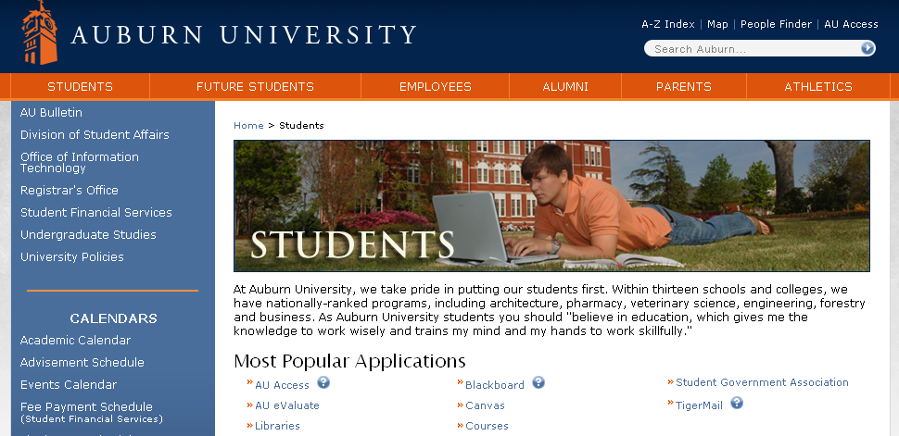

Slide 6
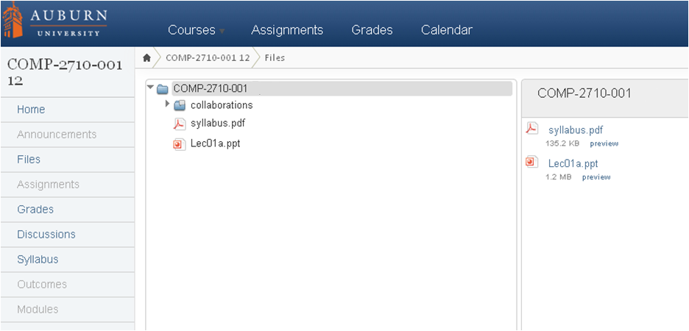

Slide 7
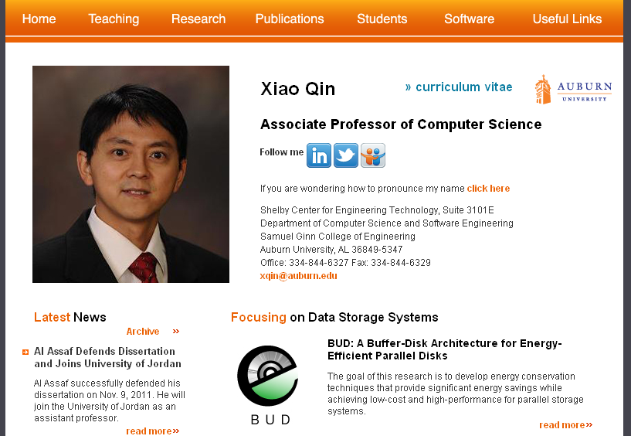

Slide 8
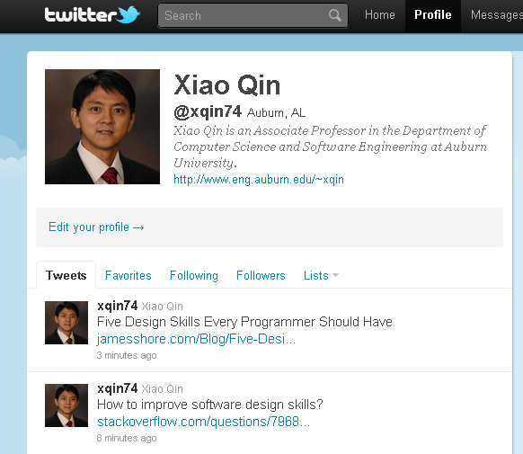

Slide 9
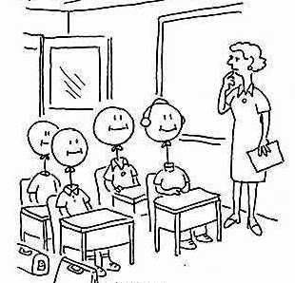
Goal and Objectives
Goal: Compete for positions in the job market or in graduate schools.
Objective 1: Grasp both C++ Syntax and Semantics
Objective 2: Design, implement, and test software
Programming skills
Software design skills

Slide 10
Your Future Career
Careers: Comp. Sci & Eng., Electrical Eng.
Phone and On-site Interviews
Programming skills
Problem solving skills
Personality
Quickly learn a new programming language
Programming experience

Slide 11
COMP 4300 Computer Architecture (Java, C++; C)
COMP 3500 Intro to Operating Systems (C)
COMP 2710 Software Construction (C++)
COMP 2210 Fundamentals of Computing II (Java)
COMP 1210 Fundamentals of Computing I (Java)

Slide 12
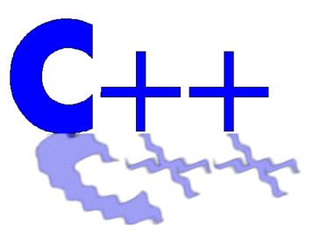
Why Study Software Construction?

Slide 13

C++ Applications
Adobe Systems:
All major applications are developed in C++:
  Photoshop & ImageReady,
  Illustrator,
  Acrobat,
  InDesign,
  GoLive,
  Frame (mostly C, some C++)

Slide 14
C++ Applications (cont).
Amazon.com: Software for large-scale e-commerce.
Google: web search engine, etc.
  Chromium browser.
  Google file system.
  MapReduce large cluster data processing.
HP: Here is a tiny fraction of HP's C++ apps:
  C, C++, Fortran90 compilers, and linker for the new HP IA64 platform (these add to more than 1 million lines of C++ code).
  SAM (HP's system management utility)
  Some of the networking libraries in HP-UX
  Java VM core
IBM:
  OS/400.
  K42: a high performance, open source, general-purpose operating system kernel for cache-coherent multiprocessors.
http://www.research.att.com/~bs/applications.html

Slide 15
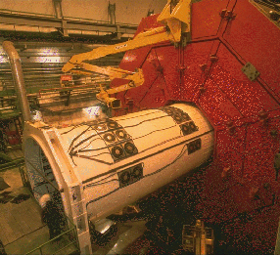

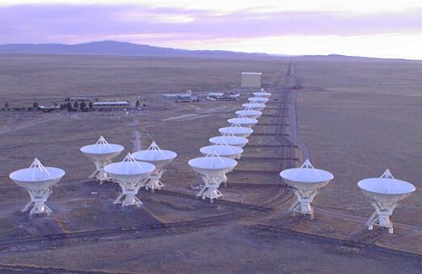
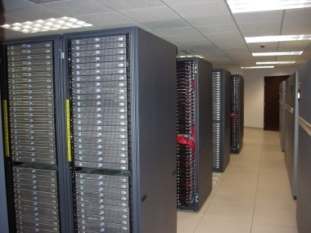
Parallel Applications on Supercomputers
Notes:
biological sequence analysis
Radio Astronomy Observatory

Slide 16

Why Study Software Construction?
Position | Software Engineer - (Posted on 8/13/2011)
Location | Seattle, WA
Company | Amazon
Part of the Job Description | Basic Qualifications * Bachelor's Degree or better in Computer Science or related field. * 4+ years professional experience in software development. * Computer Science fundamentals in object-oriented design, problem solving, data structures and algorithm design * Proficiency in, at least, one modern programming language such as C++, C# and Java. Perl experience a plus.

Slide 17

Why Study Software Construction?
Position | Software Test Specialist - (Posted on 8/14/2010)
Location | San Jose, California
Company | IBM
Part of the Job Description | Applicant should possess a strong programming language such as C, C++ or Java. Command of a non-Windows platform such as Linux or UNIX is also a plus. The applicant should possess any number of the following abilities: Java, C++, C, Linux, Windows, TCP/Networking, Websphere, DB2, Rational Tools, Project Management.

Slide 18

Why Study Software Construction?
Position | Senior Software Engineer - (Posted on 8/15/2009)
Location | Washington, DC
Company | Intel
Part of the Job Description | You should possess at least a Bachelor of Science degree and possibly more advanced degrees with extensive experience as graphics programmer in the video game industry. Additional qualifications include: - Solid understanding of Direct X*, OpenGL*, and Shaders* - Strong experience with C/C++ language and Windows* development environment - A good communicator and comfortable with public speaking - Multithreading experience and computer architecture knowledge would be an added advantage

Slide 19

Why Study Software Construction?
Position | Software Engineer, Compilers (Posted on 8/16/2009)
Location | Mountain View, CA
Company | Google
Part of the Job Description | Responsibilities: * Performance analysis * Development of advanced tools * Implement state of the art compiler optimizations * Integration into the GCC public repository Requirements: * Comprehensive and recognized knowledge in compilers, optimization technology, and algorithms * Deep understanding of computer architecture * Strong debugging/analytical skills * Solid practical C/C++ experience

Slide 20
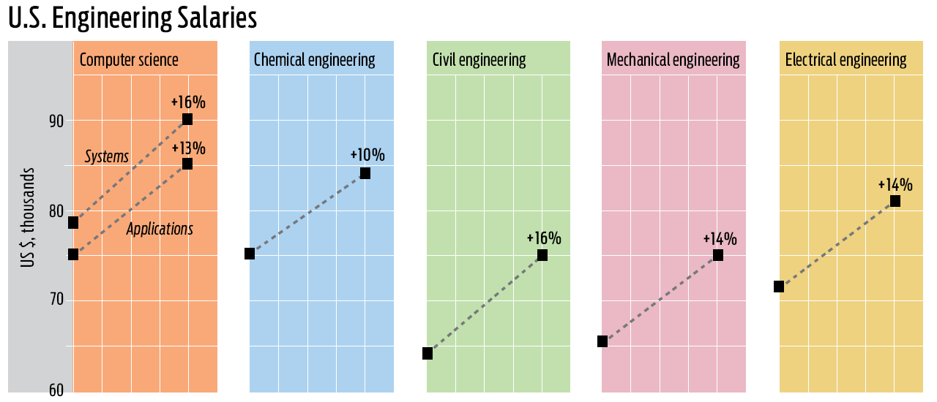
Why Study Software Construction?

Slide 21
Learn COMP2710 for Fun
To write fun applications!
Four projects (2 out of 4 will be chosen)
  An Encryption/Decryption Tool
  A Banking Application
  Text-Based Game
  A Scientific Application
1-<number>
Notes:
The games' key systems includes graphics, world simulation, game play, input, Artificial Intelligence (AI), Physics, User Interface (UI), multiplayer support etc.

Slide 22

Questions
Please ask at any time!

Slide 23
What will you get out of COMP2710?
Analyze problems to determine system requirements
Develop object-oriented software designs that map to requirements identified in analysis
Develop software using sound programming principles
Grasp both C++ Syntax and Semantics
Have experience in developing non-trivial software applications
Understand concepts of data abstraction, efficiency, and memory management
Understand how to perform software testing.

Slide 24
Topic Coverage
Covers (These topics may change)
  Administrative Stuff (Lecture 1)
  C++ Intro: History, Basics, through Flow of Control (Lectures 1-2)
  I/O: Basic, File (Lecture 3)
  Functions: Basics, Overloading, Templates (Lectures 4-6)
  Arrays (Lecture 7)
  Structures & Classes: Basics, Constructors (Lectures 8 – 10)
  Software Process (Basics of Analysis, Design, and Testing) (11-13)
  Midterm Exam (Lecture 14)

Slide 25
Topic Coverage (cont.)
  Vectors and Iterators (Lecture 15)
  Operator Overloading (Lectures 16-17)
  Strings and Streams (Lectures 18-20)
  Pointers & Dynamic Arrays (Lectures 21-24)
  Inheritance and Polymorphism (Lectures 25-28)
  Additional Topics covered as they occur: Separate Compilation, Makefiles, Templates
  “Flex” Lectures (Lectures 29-31)

Slide 26

Am I going to read the book to you?
NO!
Book provides a framework and complete background, so lectures can be more interactive.
  You do the reading
  We’ll discuss it
Projects will go “beyond”
Textbook: Savitch, Walter. Absolute C++,
2nd, 3rd, or 4th Edition. Addison-Wesley.

Slide 27
Course Syllabus
Prerequisite: COMP 2210 Fundamentals of Computing.
7 homework assignments and 2 project assignments.
  Due at the start of class.
  Late assignments: penalty.
1 midterm exam and 1 final exam
Grading
  Quizzes 15%
  Midterm 20%
  Final Exam 20%
  Homework 15%
  Lab Assignment 30%
Notes:
The syllabus is available on the course web site.
Read syllabus carefully after class
Prerequisite: Ask students’ background in assembly languages

Slide 28
Course Syllabus (cont.)
Scale
  A [90, 100], B [80,90), C [70,80), D [60,70), F [0,60)
  Note: In order to pass the class, you must receive at least 60% credit on the Individual Construction Projects and Homework, regardless of performance on exams.
Cheating
  All assignments have to be done individually.
  Students may discuss with their friends.
  Assignments submitted must be yours.
  Please do not attempt to recycle answers from the Internet (plagiarism).
Notes:
The syllabus is available on the course web site.
Read syllabus carefully after class
Prerequisite: Ask students’ background in assembly languages
Possible penalties: Zero on assignment (minimum), failure course, note on permanent record, suspension.

Slide 29
Office Hours
Dr. Qin’s Office hours: MWF, 1:00 pm – 2:00 pm
Shelby Center for Engineering Technology, Suite 3101E
GTA: Sankari Anupindi
Office: 2113 Shelby Center
Office Hours: MW 11:00 am – 12:30 pm

Slide 30
For Next Time…
Read Chapter 1 – C++ Basics
Notes:
How hard to build
Importance of simplicity (wearing a seat belt); avoiding a personal disaster
Theory vs. practice

Slide 31
Your Feedback
Not-A-Quiz (Anonymously)
What are your expectations?
What are your career goals?
Write your reactions to the first day

